Slide 1
Applied Cryptography public-key cryptosystem, RSA
Liangfeng Zhang
School of Information Science and Technology
ShanghaiTech University

Slide 2

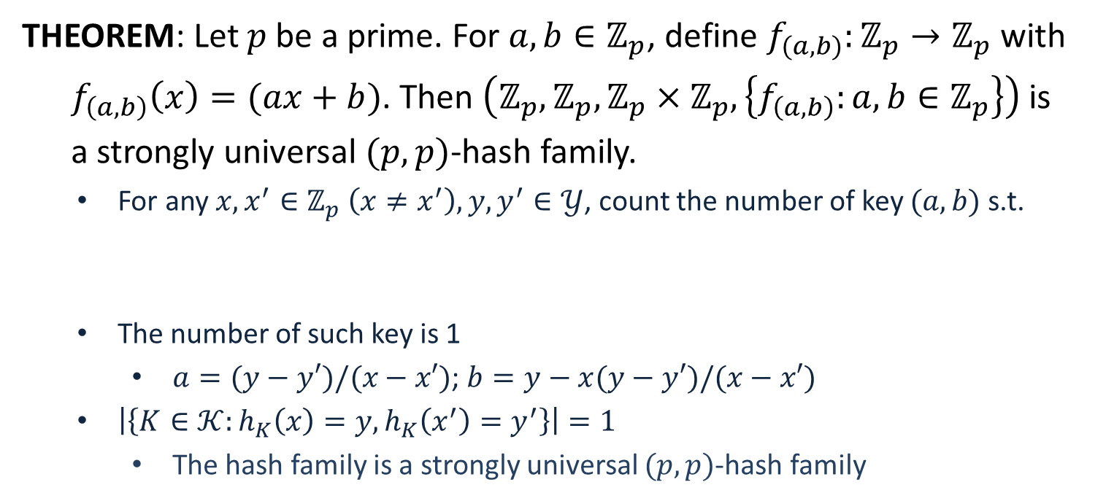


Construction
THEOREM: Let $p$ be a prime. For $a,b∈ℤ_{p}$, define $f_{(a,b)}:ℤ_{p}→ℤ_{p}$with
$f_{\left(a,b\right)}\left(x\right)=(ax+b)$. Then $\left(ℤ_{p},ℤ_{p},ℤ_{p}×ℤ_{p}, \left\{f_{\left(a,b\right)}:a,b∈ℤ_{p}\right\}\right)$ is
a strongly universal $(p,p)$-hash family.
For any $x,x^{′}∈ℤ_{p} \left(x≠x^{′}\right), y,y^{′}∈𝒴$, count the number of key $(a,b)$ s.t.
The number of such key is 1
$a=(y−y′)/(x−x′)$; $b=y−x(y−y′)/(x−x′)$
$\left|\left\{K∈𝒦:h_{K}\left(x\right)=y, h_{K}\left(x^{′}\right)=y^{′}\right\}\right|=1$
The hash family is a strongly universal $(p,p)$-hash family
$f_{\left(a,b\right)}\left(x\right)=y$
$f_{\left(a,b\right)}\left(x^{′}\right)=y′$
$ax+b=y$
$ax^{′}+b=y′$
$$=\left|𝒦\right|/M^{2}$$

Slide 3
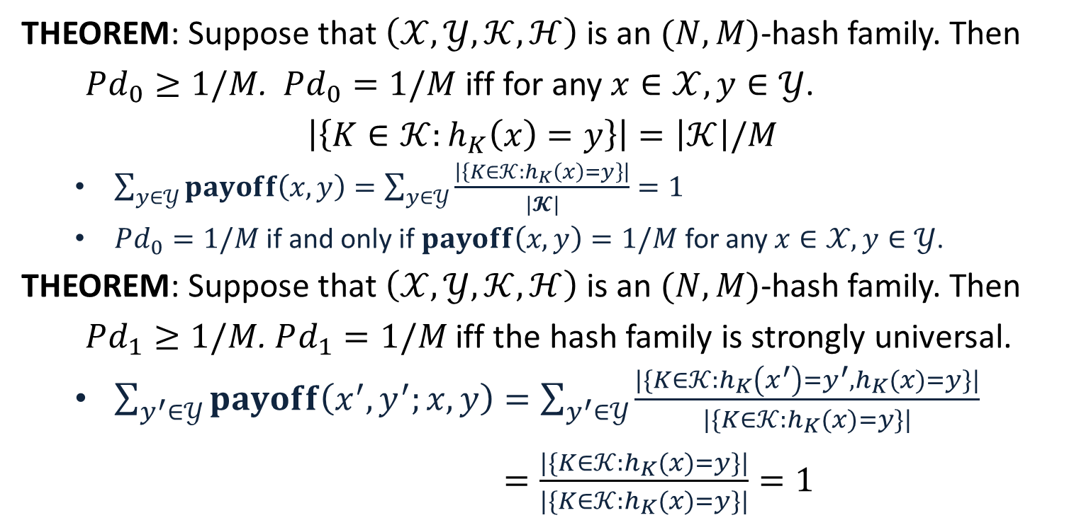
Optimality
THEOREM: Suppose that $\left(𝒳,𝒴,𝒦,ℋ\right)$ is an $(N,M)$-hash family. Then
$Pd_{0}≥1/M$. $Pd_{0}=1/M$ iff for any $x∈𝒳, y∈𝒴$.
$$\left|\left\{K∈𝒦:h_{K}\left(x\right)=y\right\}\right|=\left|𝒦\right|/M$$
$\sum_{y∈𝒴}{payoff\left(x,y\right)}=\sum_{y∈𝒴}{\frac{\left|\left\{K∈𝒦:h_{K}\left(x\right)=y\right\}\right|}{|𝓚|}}=1$
$Pd_{0}=1/M$ if and only if $payoff\left(x,y\right)=1/M$ for any $x∈𝒳, y∈𝒴$.
THEOREM: Suppose that $\left(𝒳,𝒴,𝒦,ℋ\right)$ is an $(N,M)$-hash family. Then
$Pd_{1}≥1/M$. $Pd_{1}=1/M$ iff the hash family is strongly universal.
$\sum_{y^{′}∈𝒴}{payoff\left(x^{′},y^{′};x,y\right)}=\sum_{y^{′}∈𝒴}{\frac{|\{K∈𝒦:h_{K}\left(x^{′}\right)=y^{′}, h_{K}(x)=y\}|}{|\{K∈𝒦:h_{K}(x)=y\}|}}$
$=\frac{|\{K∈𝒦:h_{K}(x)=y\}|}{|\{K∈𝒦:h_{K}(x)=y\}|}=1$

Slide 4
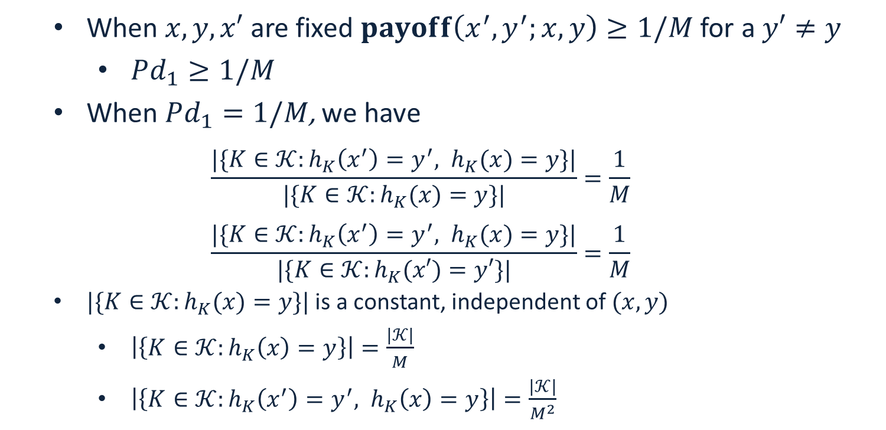
Optimality
When $x,y,x′$ are fixed $payoff\left(x^{′},y^{′};x,y\right)≥1/M$ for a $y′≠y$
$Pd_{1}≥1/M$
When $Pd_{1}=1/M$, we have
$$\frac{|\{K∈𝒦:h_{K}\left(x^{′}\right)=y^{′}, h_{K}(x)=y\}|}{|\{K∈𝒦:h_{K}(x)=y\}|}=\frac{1}{M}$$
$$\frac{|\{K∈𝒦:h_{K}\left(x^{′}\right)=y^{′}, h_{K}(x)=y\}|}{|\{K∈𝒦:h_{K}(x′)=y′\}|}=\frac{1}{M}$$
$|\{K∈𝒦:h_{K}(x)=y\}|$ is a constant, independent of $(x,y)$
$\left|\left\{K∈𝒦:h_{K}\left(x\right)=y\right\}\right|=\frac{|𝒦|}{M}$
$\left|\left\{K∈𝒦:h_{K}\left(x^{′}\right)=y^{′}, h_{K}\left(x\right)=y\right\}\right|=\frac{|𝒦|}{M^{2}}$

Slide 6




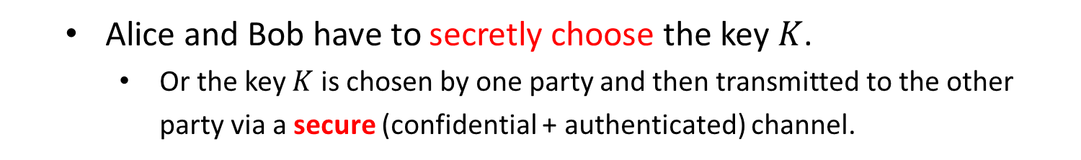


Secret-Key Cryptosystem
Charlie
$$x$$
$$y$$
$$x$$
Alice
encrypter
decrypter
Bob
$$K$$
$$K$$
secure channel
secure channel
$$K$$
key source
Alice and Bob have to secretly choose the key $K$.
Or the key $K$ is chosen by one party and then transmitted to the other party via a secure (confidential + authenticated) channel.

Slide 7


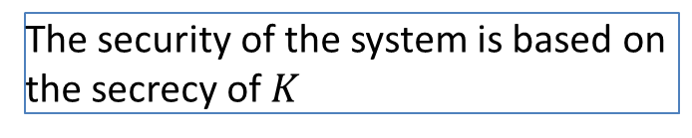
Secret-Key Cryptosystem
Charlie
$$x$$
$$y$$
$$x$$
Alice
encrypter
decrypter
Bob
$$K$$
$$K$$
secure channel
secure channel
$$K$$
The security of the system is based on
the secrecy of $K$
key source
Alice and Bob have to secretly choose the key $K$.
Or the key $K$ is chosen by one party and then transmitted to the other party via a secure (confidential + authenticated) channel.
If there are $n$ parties, $\left({n \atop 2}\right)$ secret keys are needed.

Slide 8




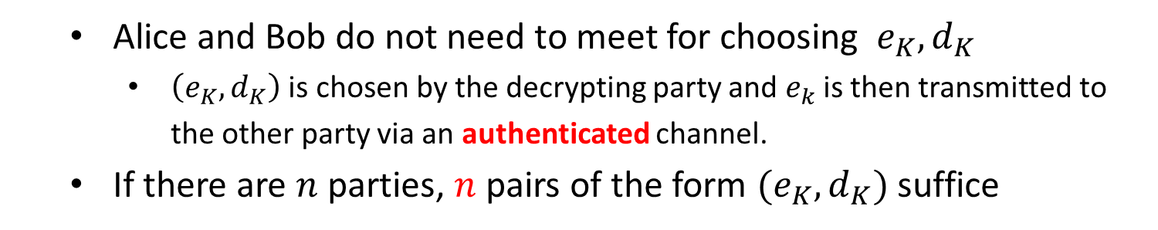
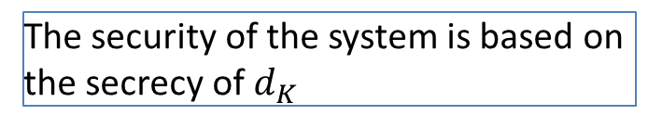

Public-Key Cryptosystem
Charlie
$$x$$
$$y$$
$$x$$
Alice
encrypter
decrypter
Bob
$$e_{K}$$
$$d_{K}$$
authenticated channel
It should be hard to derive $d_{K}$ from $e_{K}$
$$e_{K}$$
$$d_{K}$$
The security of the system is based on
the secrecy of $d_{K}$
key source
Alice and Bob do not need to meet for choosing $e_{K},d_{K}$
$\left(e_{K},d_{K}\right)$ is chosen by the decrypting party and $e_{k}$ is then transmitted to the other party via an authenticated channel.
If there are $n$ parties, $n$ pairs of the form $(e_{K},d_{K})$ suffice

Slide 9
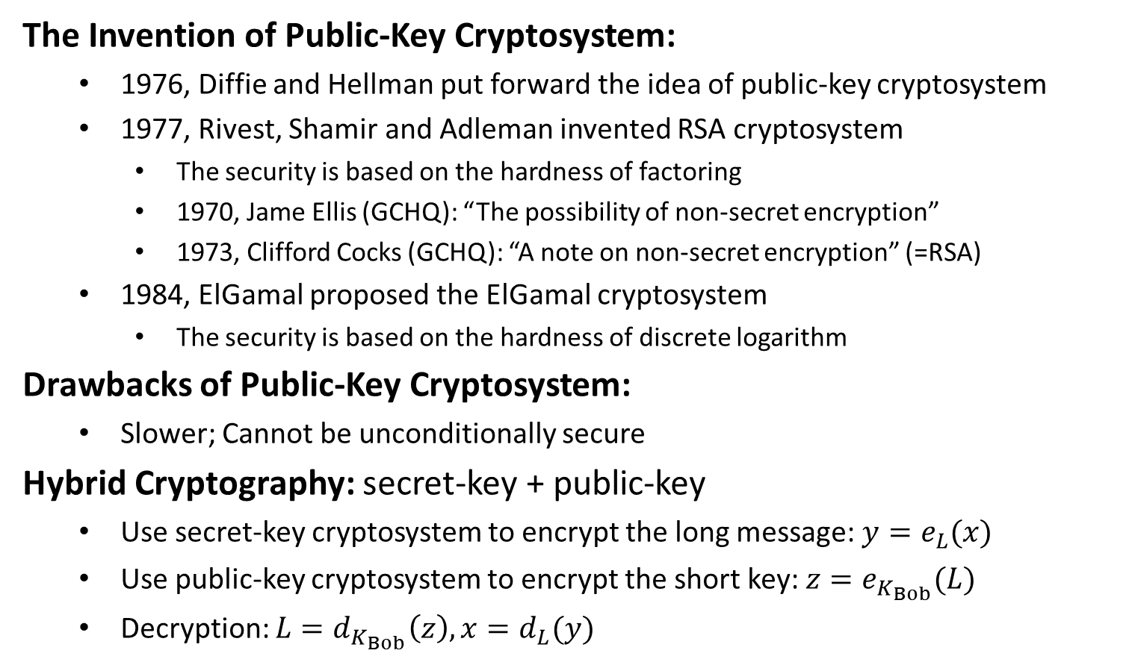
Public-Key Cryptosystem
The Invention of Public-Key Cryptosystem:
1976, Diffie and Hellman put forward the idea of public-key cryptosystem
1977, Rivest, Shamir and Adleman invented RSA cryptosystem
The security is based on the hardness of factoring
1970, Jame Ellis (GCHQ): “The possibility of non-secret encryption”
1973, Clifford Cocks (GCHQ): “A note on non-secret encryption” (=RSA)
1984, ElGamal proposed the ElGamal cryptosystem
The security is based on the hardness of discrete logarithm
Drawbacks of Public-Key Cryptosystem:
Slower; Cannot be unconditionally secure
Hybrid Cryptography: secret-key + public-key
Use secret-key cryptosystem to encrypt the long message: $y=e_{L}(x)$
Use public-key cryptosystem to encrypt the short key: $z=e_{K_{Bob}}(L)$
Decryption: $L=d_{K_{Bob}}\left(z\right), x=d_{L}(y)$

Slide 11
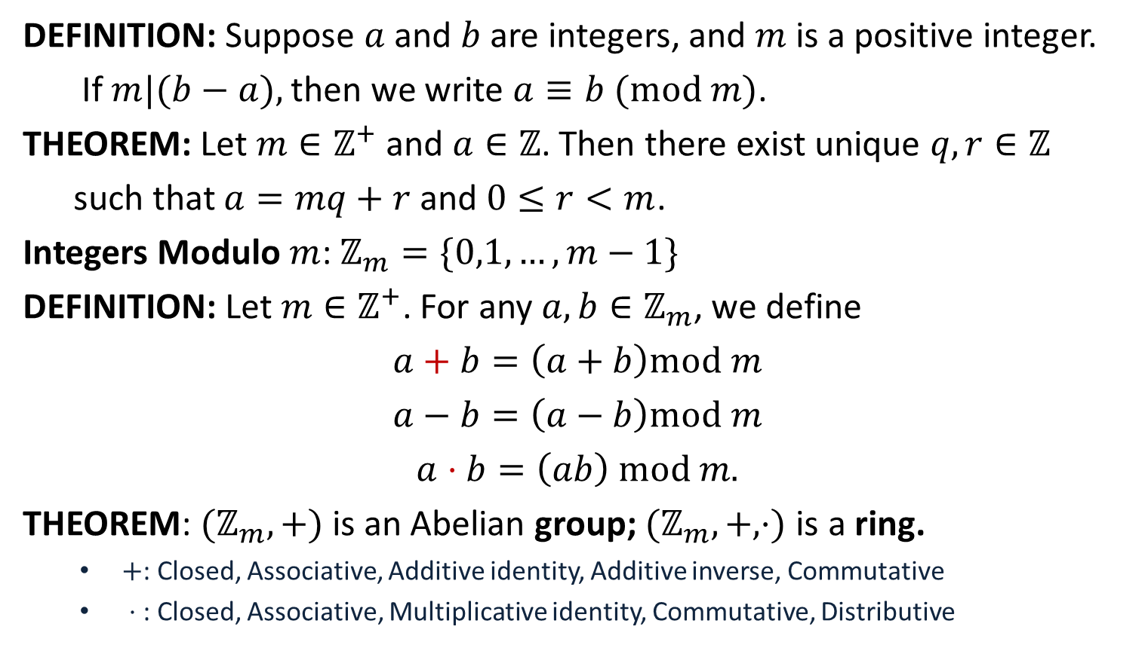
Modulo Arithmetic
DEFINITION: Suppose $a$ and $b$ are integers, and $m$ is a positive integer.
If $m|(b−a),$then we write $a≡b (mod m)$.
THEOREM: Let $m∈ℤ^{+}$ and $a∈ℤ$. Then there exist unique $q,r∈ℤ$
such that $a=mq+r$ and $0≤r<m$.
Integers Modulo $m$: $ℤ_{m}=\{0,1,…,m−1\}$
DEFINITION: Let $m∈ℤ^{+}$. For any $a,b∈ℤ_{m}$, we define
$$a+b=\left(a+b\right)mod m$$
$$a−b=\left(a−b\right)mod m$$
$$a⋅b=\left(ab\right) mod m.$$
THEOREM: $(ℤ_{m},+)$ is an Abelian group; $(ℤ_{m},+,⋅)$ is a ring.
$+$: Closed, Associative, Additive identity, Additive inverse, Commutative
$⋅$ : Closed, Associative, Multiplicative identity, Commutative, Distributive

Slide 12
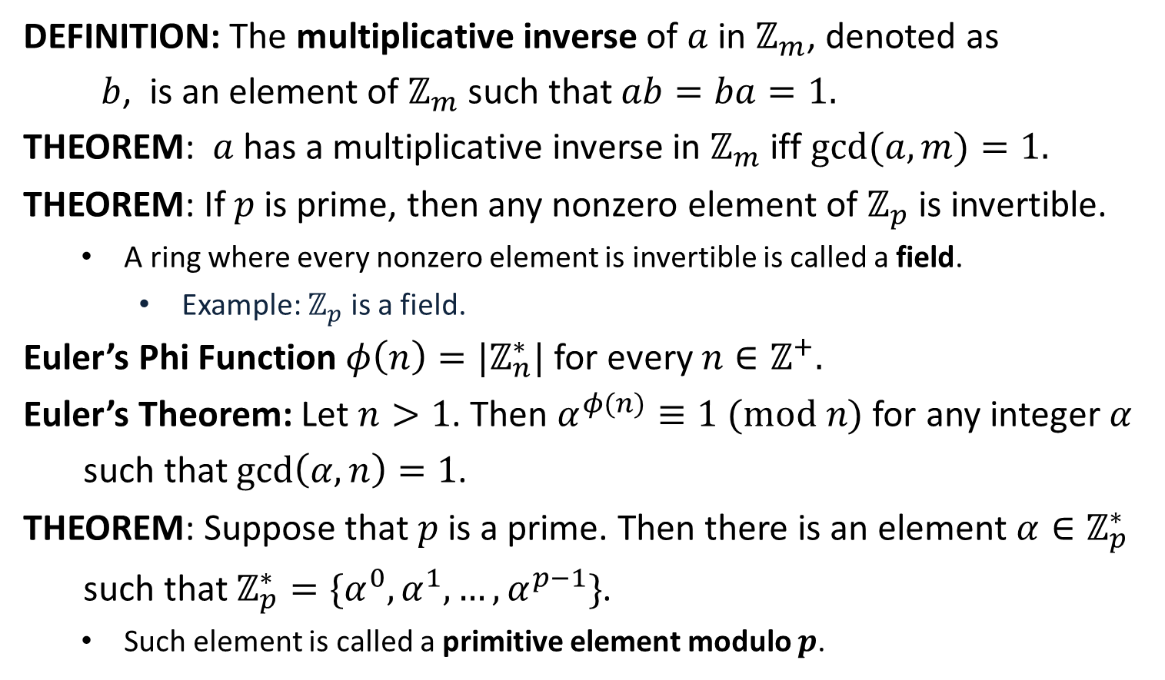
Modulo Arithmetic
DEFINITION: The multiplicative inverse of $a$ in $ℤ_{m}$, denoted as
$b$, is an element of $ℤ_{m}$ such that $ab=ba=1.$
THEOREM: $a$ has a multiplicative inverse in $ℤ_{m}$ iff $gcd⁡(a,m)=1.$
THEOREM: If $p$ is prime, then any nonzero element of $ℤ_{p}$ is invertible.
A ring where every nonzero element is invertible is called a field.
Example: $ℤ_{p}^{ }$ is a field.
Euler’s Phi Function $φ\left(n\right)=|ℤ_{n}^{∗}|$ for every $n∈ℤ^{+}.$
Euler’s Theorem: Let $n>1$. Then $α^{φ(n)}≡1 (mod n)$ for any integer $α$
such that $\gcd\left(α,n\right)=1$.
THEOREM: Suppose that $p$ is a prime. Then there is an element $α∈ℤ_{p}^{∗}$
such that $ℤ_{p}^{∗}=\{α^{0},α^{1},…, α^{p−1}\}$.
Such element is called a primitive element modulo $p$.

Slide 13
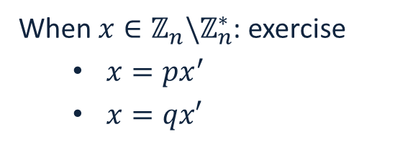
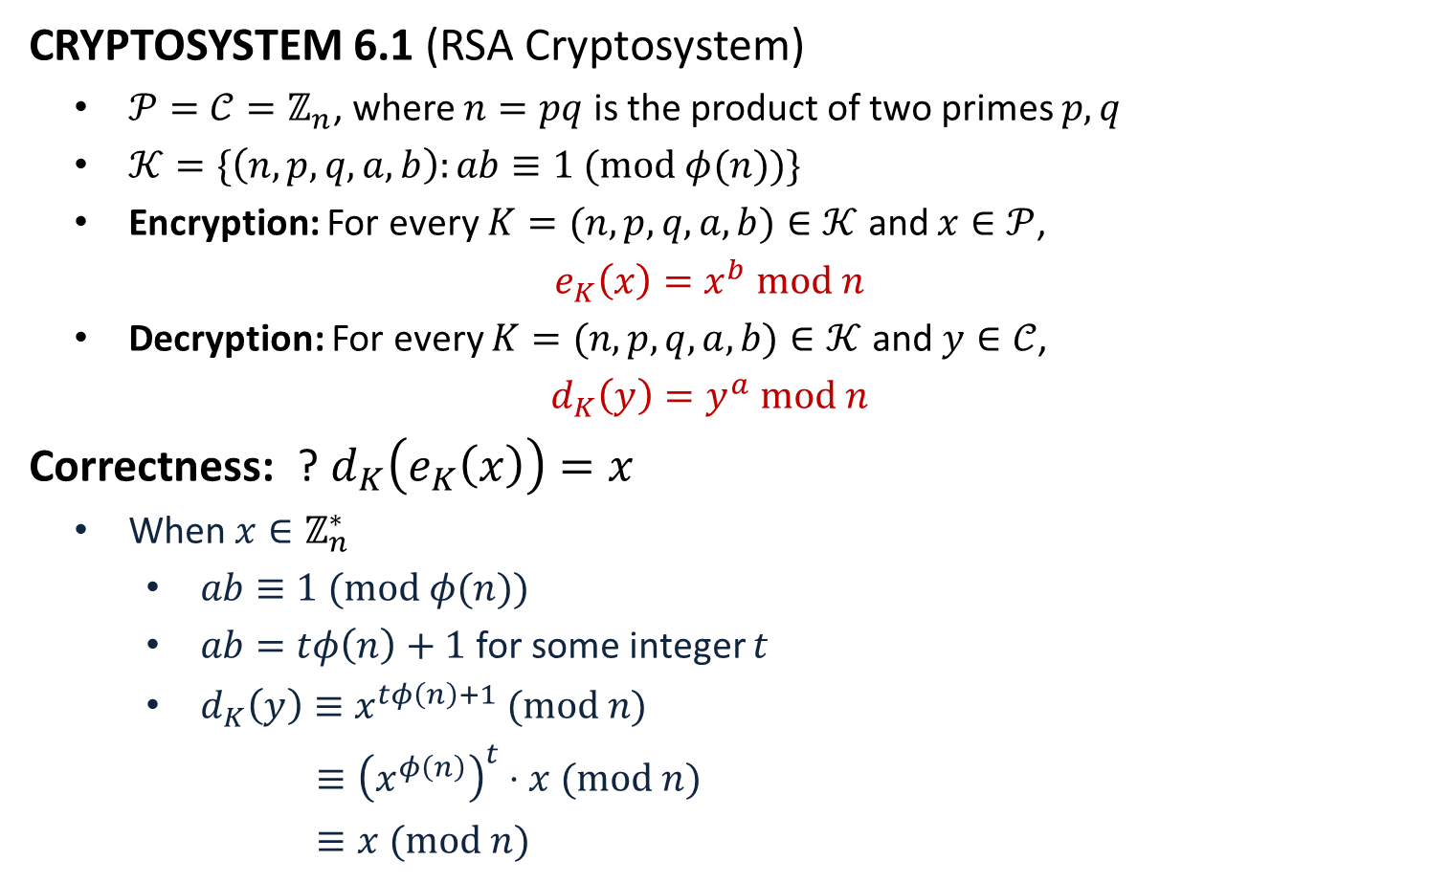
The RSA Cryptosystem
CRYPTOSYSTEM 6.1 (RSA Cryptosystem)
$𝒫=𝒞=ℤ_{n}$, where $n=pq$ is the product of two primes $p,q$
$𝒦=\{\left(n,p,q,a,b\right):ab≡1 (mod φ(n))\}$
Encryption: For every $K=(n,p,q,a,b)∈𝒦$ and $x∈𝒫$,
$$e_{K}\left(x\right)=x^{b} mod n$$
Decryption: For every $K=(n,p,q,a,b)∈𝒦$ and $y∈𝒞$,
$$d_{K}\left(y\right)=y^{a} mod n$$
Correctness: ? $d_{K}\left(e_{K}\left(x\right)\right)=x$
When $x∈ℤ_{n}^{∗}$
$ab≡1 (mod φ(n))$
$ab=tφ\left(n\right)+1$ for some integer $t$
$d_{K}\left(y\right)≡x^{tφ\left(n\right)+1} (mod n)$
$≡{\left(x^{φ\left(n\right)}\right)}^{t}⋅x (mod n)$
$≡x (mod n)$
When $x∈ℤ_{n}\backslash ℤ_{n}^{∗}$: exercise
$x=px^{′}$
$x=qx′$

